Slide 1
Time Series for Beginners
Alexander Baker

Slide 2
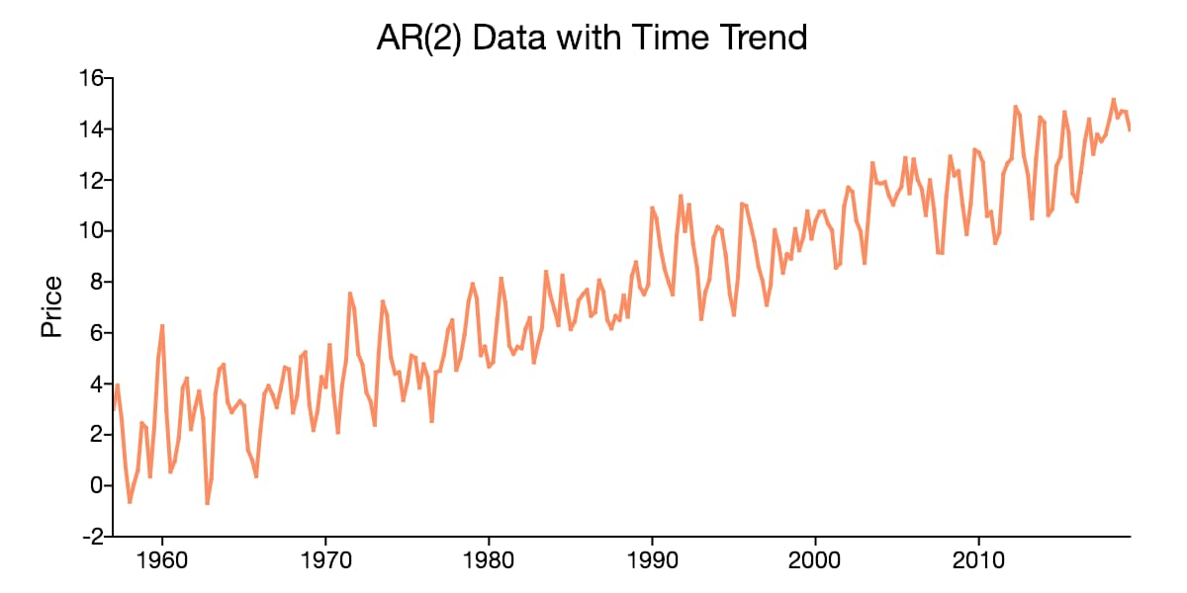
What is a Time Series
A time series is a sequence of data points in chronological order
Typically a time series is distributed evenly for each chronological increment (daily time series, there will be one point each day)
Time series analysis is done to analyze how a certain variable acts with respect to time
This can be useful for analyzing stock prices, climate change, weather, etc.

Slide 3
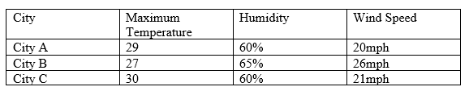
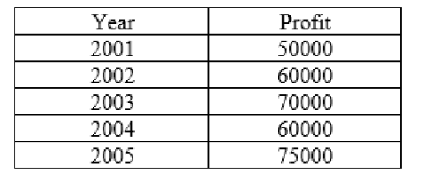
Cross Sectional vs Time Series
Cross sectional data display several variables and individuals at a given point in time
Time series data is the observation of a single entity at numerous points in time
Different types of analyses are important for each type of data
A bank can analyze attributes that result in a loan default, this is cross sectional analysis
A bank can analyze the number of defaulted loans month by month, this is time series analysis
There can be cross sectional time series data with multiple individuals at multiple points in time

Slide 4

Why is Time Series Important
Everything has behaviors, habits, and changes as time progresses
Looking back on previous behaviors, it can give us ideas on how an entity might act in the future
Understanding past behaviors, and predicting future behaviors will allow an organization to preemptively adapt to future conditions
This can also capture trends with respect to major shocks
There is provides value in a variety of settings, not only for finance, but humanitarian organizations, scientists, human resources, etc.

Slide 5

Creating your Time Series Problem
Narrow down your desired time series to a single or select number of important variables
Identify the the period in which your time series will be relevant, e.g. if you’re analyzing traffic patterns, maybe going back to the early 1900s may be irrelevant to the behaviors of the modern day
Identify the relevant frequency in which your time series will be based on, i.e. day, month, year, quarter, etc.
For example, quarters or years may be more useful for business performance compared to days.

Slide 6
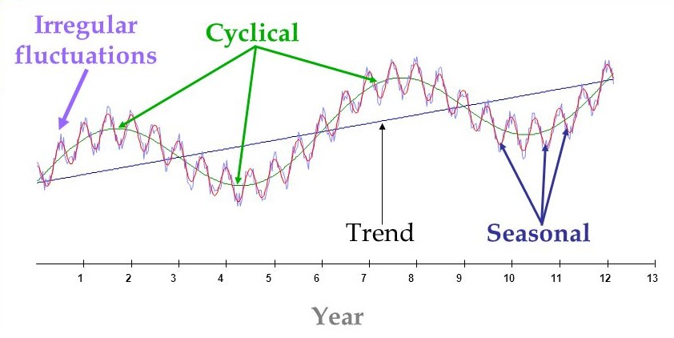
Time Series Components
Trend - Long term behavior or changes of time series data
Seasonality - Regular predictable time series behavior between similar periods of time
Cycles - No fixed interval of time series behaviors and patterns
Irregularity - Unexpected situations and events that cause huge time series behavioral changes
Lags - an incremental time difference between two points, i.e. current day is lag yt, yesterday would be yt-1, the day before would be yt-2, etc.
Trends and cycles are often captured together within a time series

Slide 7
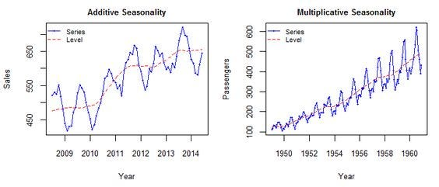
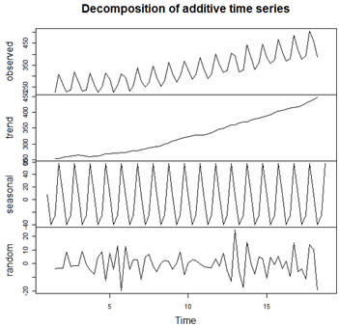
Decomposition Models
Decomposition models can give a good overview of various aspects of the time series
With this decomposition, we can isolate the trends, seasonality, and noise
Additive and multiplicative are the two main methods of decomposition
Additive models are best used when the seasonal variation remains consistent over time
Multiplicative models are best used when seasonal variation increases over time
Additive time series:
x1 = Trend + Seasonal + Noise
Multiplicative time series:
x1 = Trend * Seasonal * Noise
In the additive series each component is subtracted from the series to perform the decomposition
In the multiplicative series, the series is divided by each component to perform the decomposition

Slide 8
Autoregression
This is one of the main components of a time series model
As the name suggests, this creates a linear model to predict the current value based on a number of past values
An autoregressive order refers to the number of past terms multiplied by coefficients.
An error term is added to the equation to in order to account for white noise

Slide 9
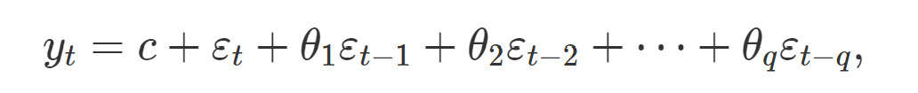
Moving Average
Moving average model is an additional component that can be used for a time series model
The moving average model creates a linear regression model using residuals
The order refers to the number of coefficients and error terms of past values
The equation also includes an error term to incorporate noise

Slide 10
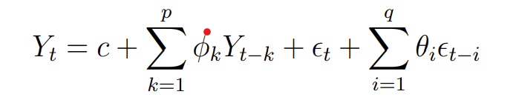
Autoregressive Moving Average - ARMA Model
ARMA combines the autoregressive equation with the moving average equation.
This model combines the information gathered from the previous autoregressive terms, and the previous error terms to predict the next value
Using the information of the past values and errors, we have a new more powerful model to predict future values

Slide 11
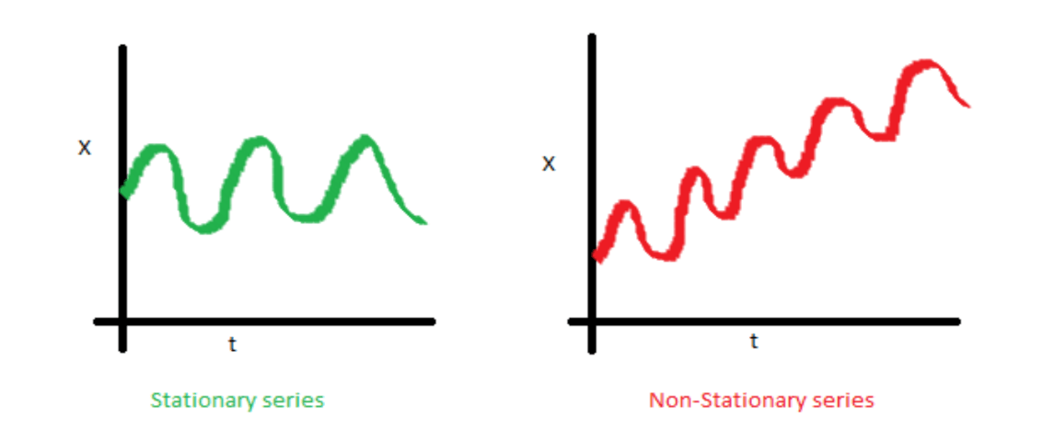
Stationarity and Augmented Dickey-Fuller Tests
Stationarity is a time series with internal properties that do not depend on time
The mean and variance within a stationary series remains constant over time
If a mean, variance, or both change overtime, then the time series is classified as non-stationary
A modeled time series must be stationary to have a defined mean and variance
This prevents biased and poor fitting
Stationarity can be checked using the Augmented Dickey Fuller test
H0 time series is not stationary
Ha time series is stationary

Slide 12
Integration - ARIMA Model
If the series is not stationary, the current and previous terms are differenced
If the series is still non stationary,these values are differenced again
This process is repeated until stationarity is achieved
The integration order refers to the number of times a series is differenced until the time series is stationary
The ARIMA is similar to the ARMA model, but incorporates this differencing, (or integration) into its modeling

Slide 13
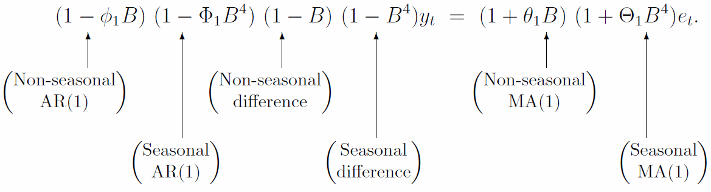
Seasonality - SARIMA models
Seasonality adds a lot of predictive power to the model due to the proper modeling in regular fluctuation
This takes data on a seasonal level, and develops seasonal counterparts (AR,MA, and I) to the non-seasonal counterparts
Seasonal differencing occurs at the start and end of the desired period
The autoregression terms are chosen using the lags of each period
The error terms for the moving average are chosen using the lags of each period

Slide 14

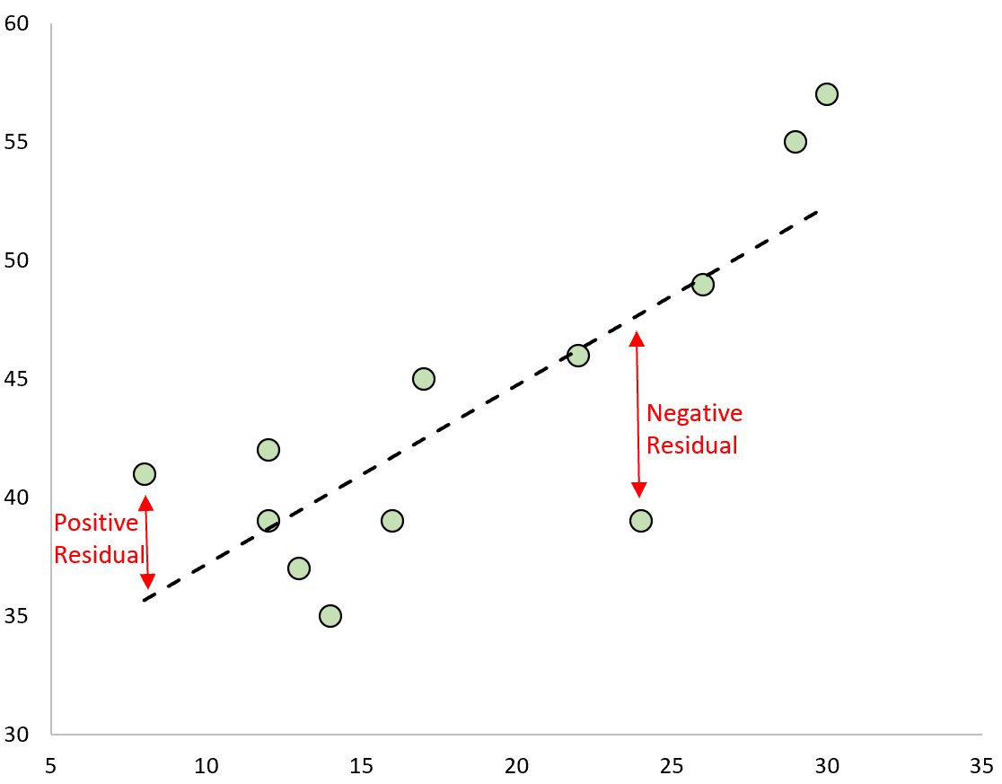
Residual Analysis
A residual is the difference between the model’s predicted value and the actual value within the series
A time series assumes the residuals are uncorrelated
A time series assumes the residuals have a mean of zero
Residuals have a consistent variance
Residuals are normally distributed
These conditions confirm an absence of bias

Slide 15
Ljung-Box test
This statistical test is meant to test whether at least one auto correlation is present within data.
It tests the entire group of autocorrelations rather than each individual one
This test is used to check if the residuals of the time series are autocorrelated.
The hypotheses are as follows:
H0: The data is independent
Ha: The data experiences serial correlation

Slide 16
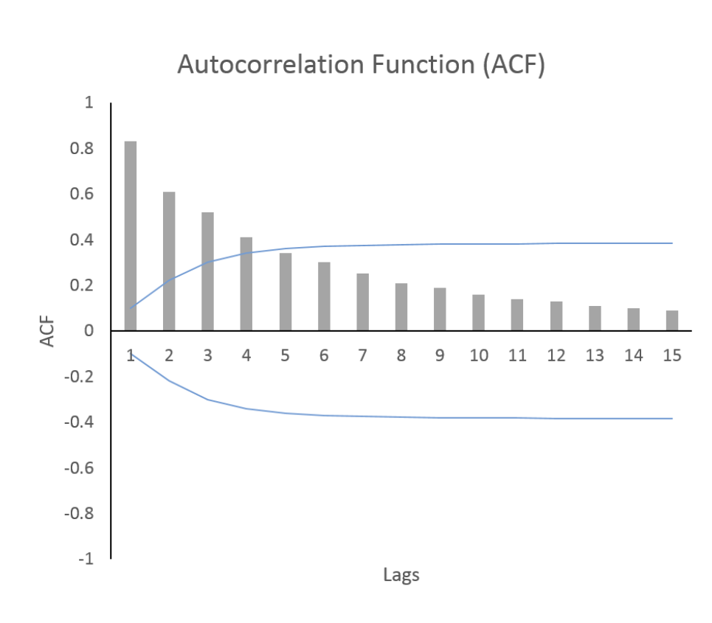
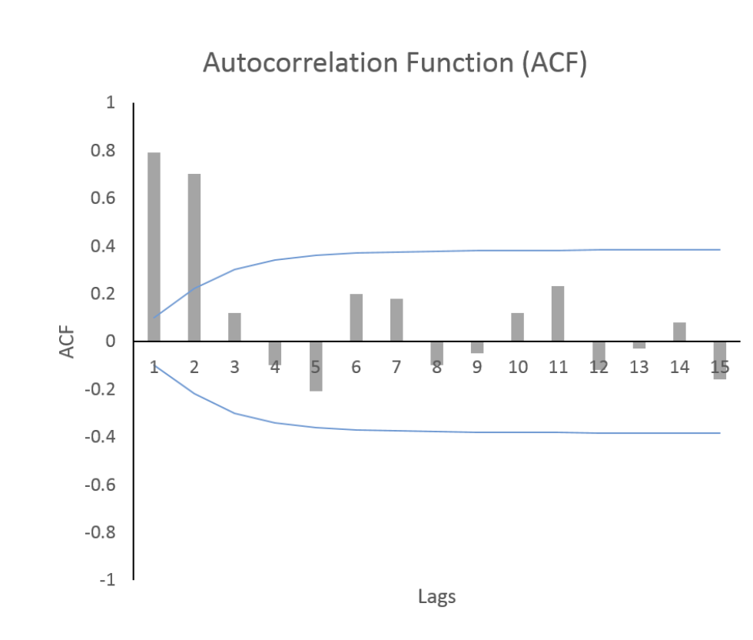
Autocorrelation Function
This is the correlation between the current lag and the previous lag
The covariance is calculated using the sample mean
This is used to find the Moving Average order in the model
Since the moving average model is based on the error, we want to include all the terms that capture significant shocks or high auto correlation between the current and previous lag

Slide 17
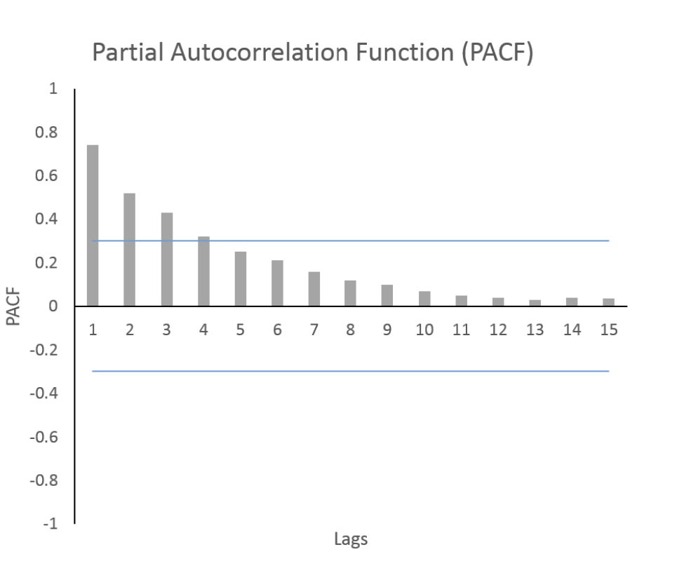
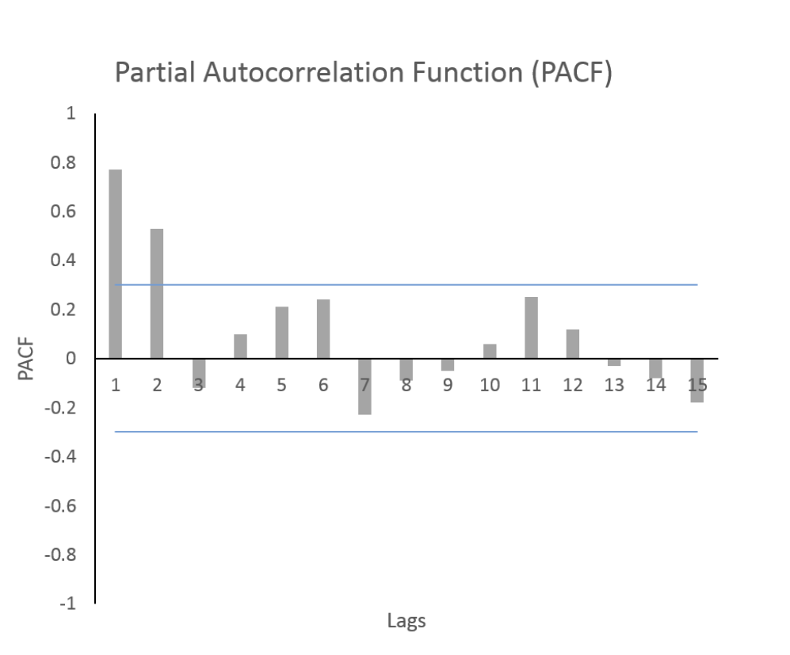
Partial Autocorrelation Function
This is a correlation term between the current lag and a selected lag in the past with the intermediate autocorrelations removed
This is used to find the Autoregression order
We would want to include the number of autoregressive terms we find to be significant, the order of the model will be based on how many lags have significant partial autocorrelations.

Slide 18
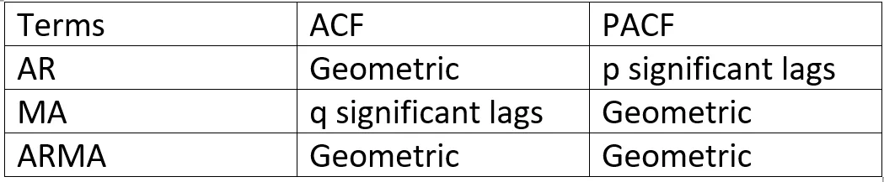
Interpreting ACF and PACF Plots
Look for the sharp drop-off within the ACF and PACF plots
The lag before the sharp drop-off will be the order
The sharp drop-off on the ACF will determine the order for the Moving Average
The sharp drop-off on the PACF will determine the order for the Autoregressive model
Geometric decay on the ACF with a drop-off on the PACF will result in an MA of 0
Geometric decay on the PACF with a drop-off on the ACF will result in an AR of 0
Geometric decays on both will result in a default ARMA model with both AR and MA orders being 1

Slide 19
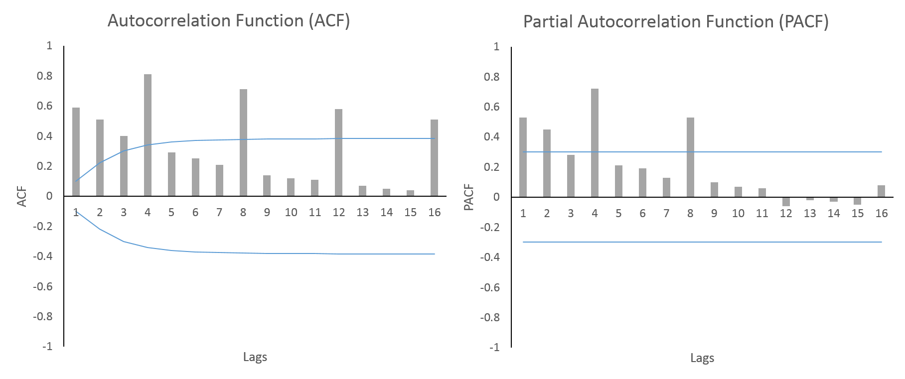
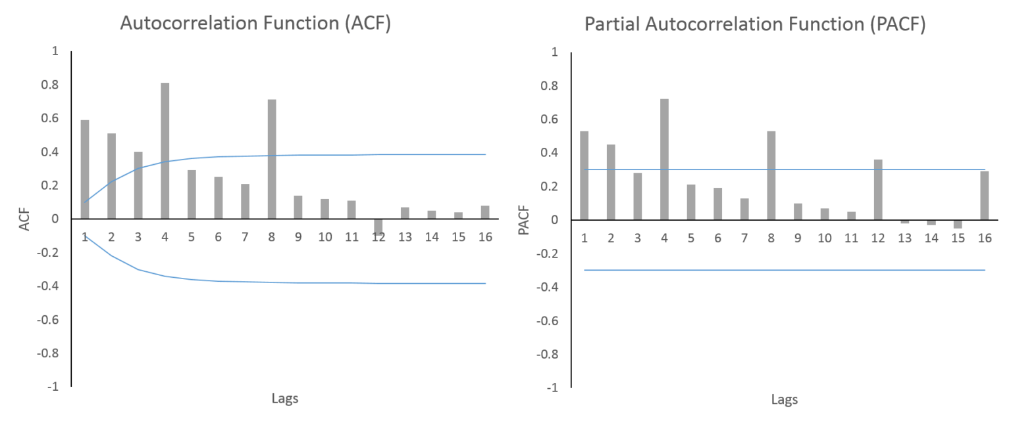
Interpreting Seasonal Orders
It is important to look at the patterns only for the relevant lags
In both example, the ACF and PACF demonstrate a period of 4 lags, as there is a spike, 3 lags, then a spike on the 4th lag
In the first example, the seasonal AR is 2 due to the drop off after the second period lag in the PACF, and an geometric decay of the ACF resulting in the seasonal MA of 0
In the second example, the seasonal MA is 2 due to the drop off after the second period lag in the ACF, and an geometric decay of the PACF resulting in the seasonal AR of 0

Slide 20
Conclusion
In this talk we discussed tha basics of the time series model
Each equally spaced point in time is known as a lag
Time series have 4 components that need to be captured within the model, the trend, cycles, seasonality, and noise.
The components of the time series model start with the autoregressive and moving average terms
Integration ensure stationarity
The seasonal counterparts of these components capture the expected fluctuations of the time series
The ACF and PACF plots can help determine the orders for AR, MA, the seasonal period, as well as the seasonal components of AR and MA.

Slide 21
Next Steps
Single, Double, and Triple exponential smoothing - this method uses exponential functions to properly capture the different elements of a time series
Vector Autoregression and Vector Autoregressive Moving Average - this method forecasts multiple time series at the same time, using the covariances between each series to establish a relationship between each series.
Facebook (from Meta, but still names Facebook) Prophet - This is Meta’s forecasting library incorporating.
Recurrent Neural Networks, and Long-term Short Memory Networks - These are deep learning approaches to time series.

Slide 22
Relevant Links
My Linkedin Page: https://www.linkedin.com/in/alexander-baker-30a6a91a2/
Iluminate AI: https://www.linkedin.com/groups/9070213/
The code and presentation will be available on Github

